Slide 1





PRODUCT AND CATEGORY ANALYSIS FOR RETAIL DATA PROJECT
Presented by: Niharika Verma
DATE: 06-08-2025
1

Slide 2
INTRODUCTION
THIS PROJECT FOCUSES ON ANALYZING A LARGE RETAIL PRODUCT CATALOG USING SQL AND POWER BI TO EXTRACT INSIGHTS ON PRODUCT PRICING, STOCK LEVELS, CUSTOMER REVIEWS, SUPPLIER PERFORMANCE, AND RETURN TRENDS.
BY CONVERTING RAW DATA INTO INTERACTIVE VISUALS, THE DASHBOARD HELPS IDENTIFY:
  HIGH/LOW-PERFORMING PRODUCTS
  LOW-STOCK AND OVERSTOCKED ITEMS
  RETURN-PRONE PRODUCTS AND WEAK SUPPLIERS
  TRENDS IN CUSTOMER SATISFACTION VIA REVIEWS
THIS SOLUTION EMPOWERS THE BUSINESS TO OPTIMIZE INVENTORY, IMPROVE PRODUCT QUALITY, AND ENHANCE CUSTOMER SATISFACTION.
2

Slide 3

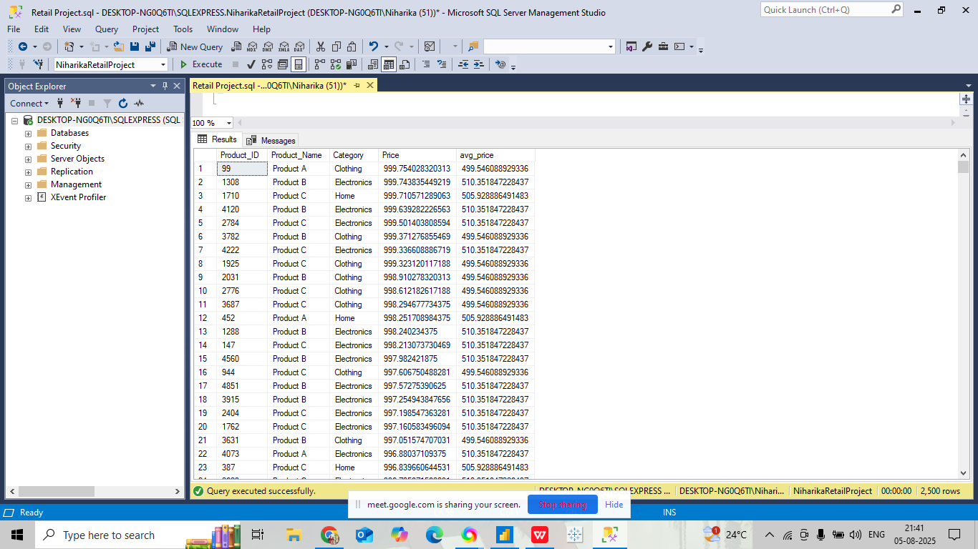
SQL QUERY ANALYSIS
  IDENTIFIES PRODUCTS WITH PRICES HIGHER THAN THE AVERAGE PRICE WITHIN THEIR CATEGORY.
3

Slide 4
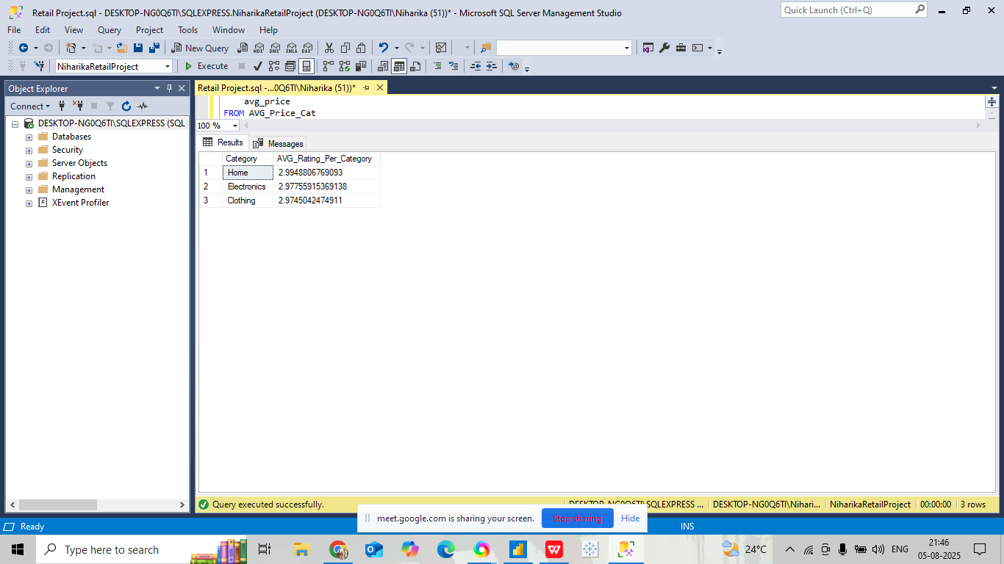
2. FINDING CATEGORIES WITH HIGHEST AVERAGE RATING ACROSS PRODUCTS.
4

Slide 5
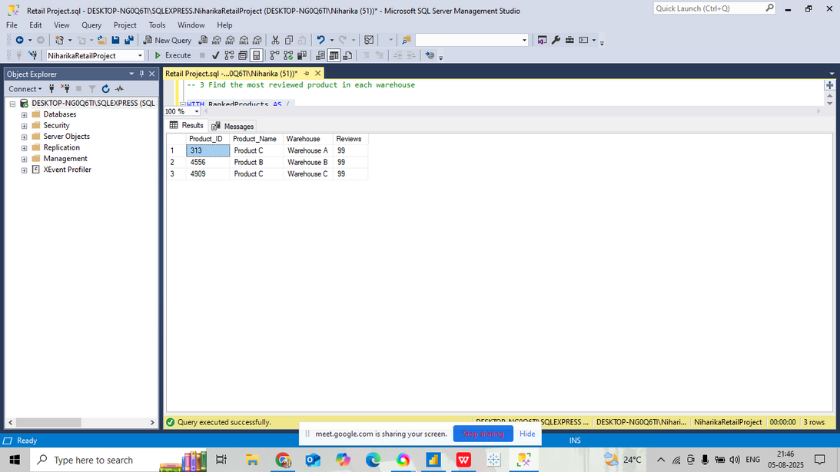
3. FIND THE MOST REVIEWED PRODUCT IN EACH WAREHOUSE
5

Slide 6
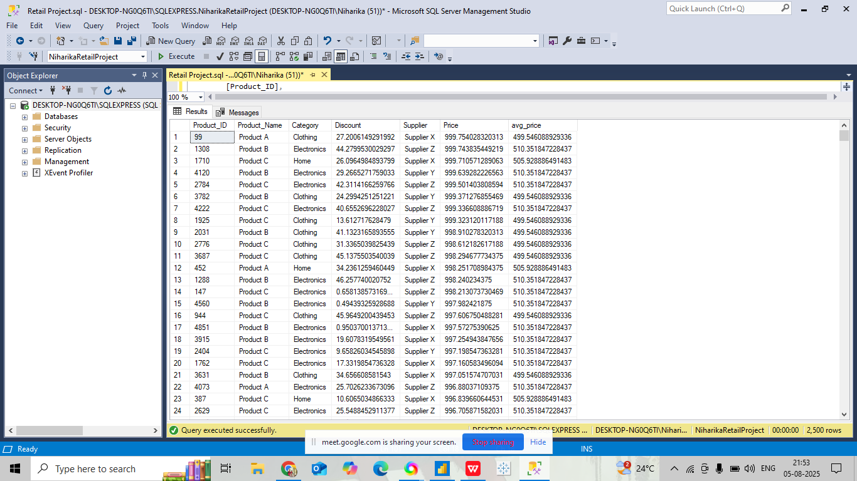
4. FIND PRODUCTS THAT HAVE HIGHER-THAN-AVERAGE PRICES WITHIN THEIR CATEGORY, ALONG WITH THEIR DISCOUNT AND SUPPLIER.
6

Slide 7
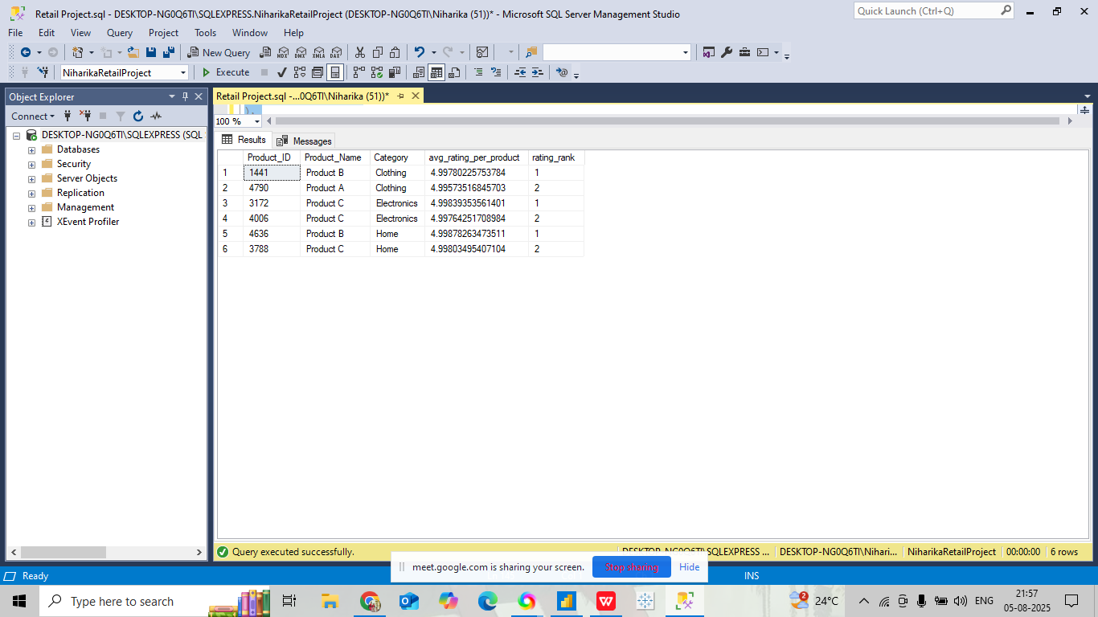
5. QUERY TO FIND THE TOP 2 PRODUCTS WITH THE HIGHEST AVERAGE RATING IN EACH CATEGORY
7

Slide 8
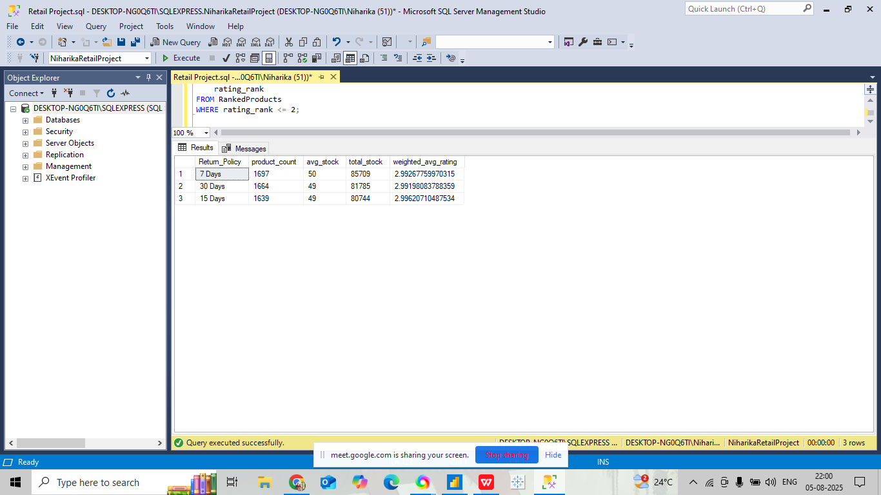
6. ANALYSIS ACROSS ALL RETURN POLICY CATEGORIES(COUNT, AVGSTOCK, TOTAL STOCK, WEIGHTED_AVG_RATING, ETC)
8

Slide 9
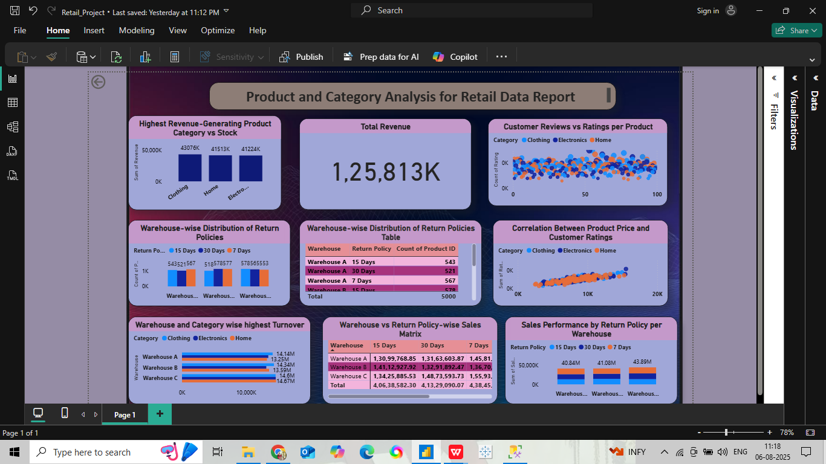
POWER BI VISUALIZATION :
9

Slide 10
Conclusion:
SQL QUERIES:
  High-Priced Products Identified
Products priced above their category average were flagged for pricing strategy review.
2. Top-Rated Products by Category
Using window functions, top 2 products with the highest average ratings in each category were identified.
3. Most Reviewed Products per Warehouse
Helped highlight products with the most customer engagement per warehouse.
4. Return Policy Analysis
7-day and 15-day policies had the highest product counts and varying stock & rating performance.
5. Supplier and Discount Insights
High-priced products were analyzed with supplier and discount details for profitability checks.
10

Slide 11
Conclusion:
POWER BI REPORT:
  Revenue Highlights
Clothing and Home were top revenue-generating categories. Warehouse C had the highest turnover.
2. Customer Sentiment
Visuals showed no direct correlation between higher price and better ratings.
3. Return Policy Trends
Warehouse-wise and return policy-wise returns were clearly mapped. 7-day policy saw the highest return counts.
4. Sales vs Return Matrix
Helped compare total sales under each return policy across warehouses—Warehouse C consistently led.
5. Interactive Filtering & Visual Correlation
Dashboards enabled dynamic insights by category, warehouse, and return policy.
11

Slide 12
THANK YOU
12

